Slide 1
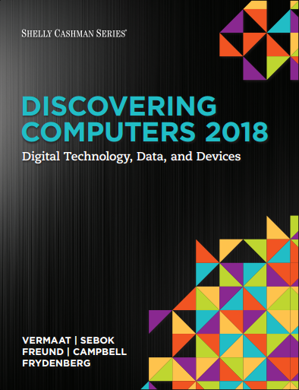

DISCOVERING COMPUTERS 2018 Digital Technology, Data, and Devices
Module 4
Programs and Apps: Productivity, Graphics, Security, and Other Tools
© 2018 Cengage版權所有，為課本著作之延伸教材，亦受著作權法之規範保護，僅作為授課教學使用，禁止列印、影印、未經授權重製和公開散佈

Slide 2
Objectives Overview (1 of 2)
Identify the general categories of programs and apps.
Describe how an operating system interacts with applications and hardware.
Differentiate among the ways you can acquire programs and apps.
Identify the key features of productivity applications.
Identify the key features of graphics and media applications.

Slide 3
Objectives Overview (2 of 2)
Identify the uses of personal interest applications.
Identify the purpose of software used in communications.
Identify the key features of security tools.
Identify the key features of file, disk, and system management tools.

Slide 4
Programs and Apps (1 of 5)
A program, or software, consists of a series of related instructions, organized for a common purpose, that tells the computer what tasks to perform and how to perform them.
An application, or app, sometimes called application software, consists of programs designed to make users more productive and/or assist them with personal tasks.
An operating system is a set of programs that coordinates all the activities among computer or mobile device hardware:
Tools and utilities
System software

Slide 5
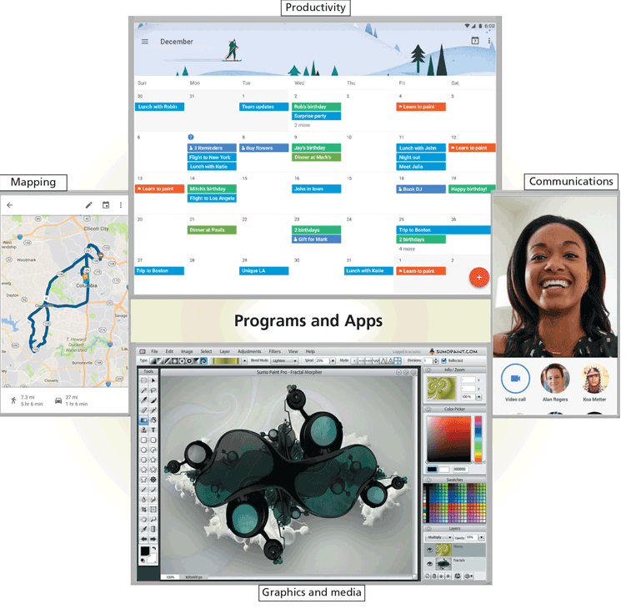
Figure 4-1 Users work with a variety of programs and apps, some of which are shown in this figure.

Slide 6
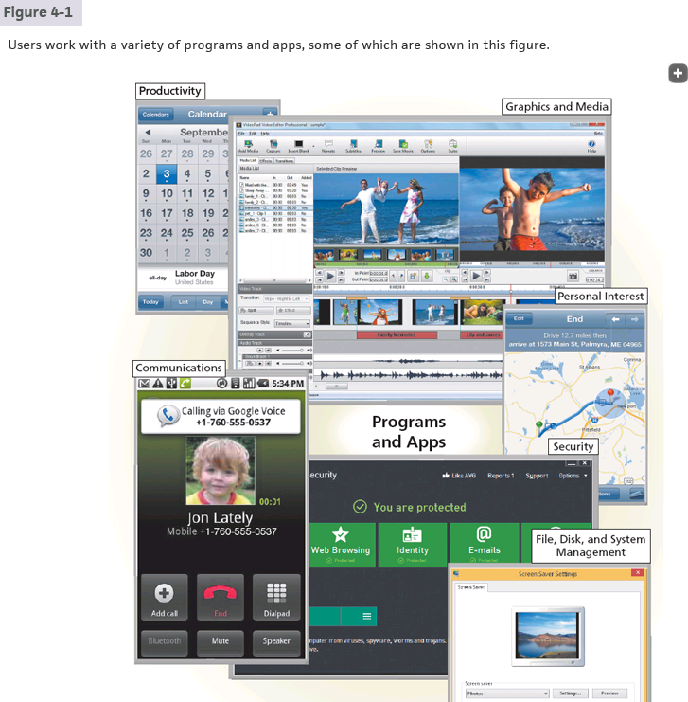

Slide 7
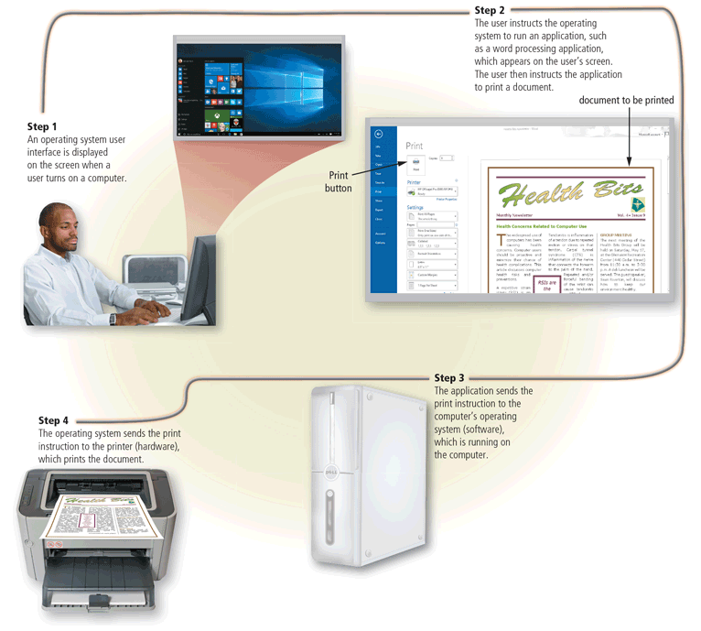
Figure 4-2 This figure shows how the operating system is the interface between the user, the application(s) and other programs, and the hardware.

Slide 8
OS
Applications
Operating System
CPU
Memory
Devices

Slide 9
OS
Program
Binary
Process
compilation
execution
Operating System!

Slide 10
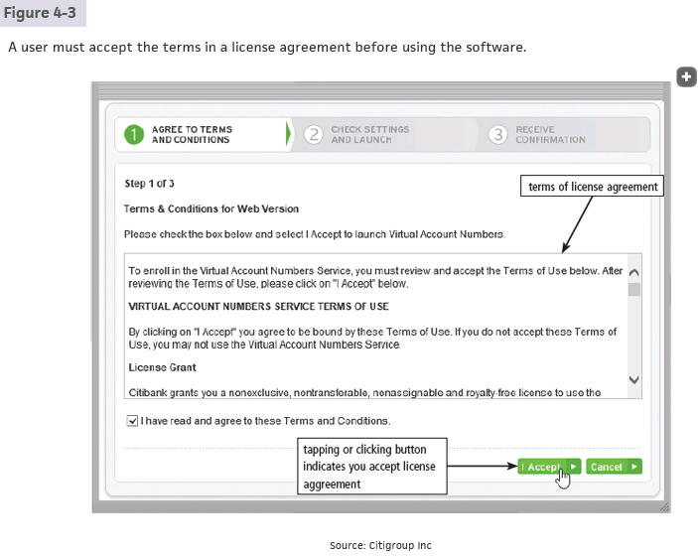

Slide 11
API(Application Program Interface)
在網頁上查天氣：
使用者按下查詢 → 前端送出Request到 API
API 接到請求 → 後端拿資料庫或外部天氣服務資料
後端把資料回傳給 API → API 將資料傳給前端
前端收到資料 → 顯示天氣資訊給使用者

Slide 12
API(Application Program Interface)
User
Front
end
Back
end
UI API
就像使用者透過UI，程式可以利用API來post request而取得資訊 e.g. web API
有什麼好處 → 可以寫程式達成自動化 e.g. 查天氣然後寄簡訊給你
限制 → 通常需要API key(可以把他想成你取得資訊的一個密碼)，很多free API key有次數限制(可能只能查10次)
怎麼用API → 看document，照著他有的功能實作

Slide 13
Programs and Apps (4 of 5)
The technologies that developers use to create apps often depends whether they will be installed on a user’s device or accessed via a network
Native app
Cloud app
Web app
Mobile web app

Slide 14
Programs and Apps (5 of 5)
Programs and apps are distributed in a variety of forms
Retail software
Custom software
Shareware
Freeware
Open source software
Public domain software

Slide 15
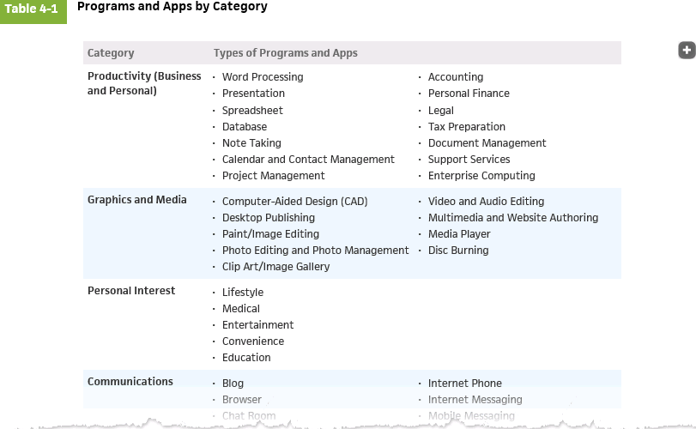

Slide 16
Productivity Applications (1 of 18)
Productivity applications can assist you in becoming more effective and efficient while performing daily activities at work, school, and home
Word processing
Presentation
Spreadsheet
Database e.g. Microsoft Access, MySQL
Note taking e.g. Microsoft OneNote
Calendar and contact management
e.g. Google Calendar(Web app), the calendar app on
your phone(native app)

Slide 17
Productivity Applications (2 of 18)
Project management
Accounting
Personal finance
Legal
Tax preparation
Document management
Support services
Enterprise computing

Slide 18
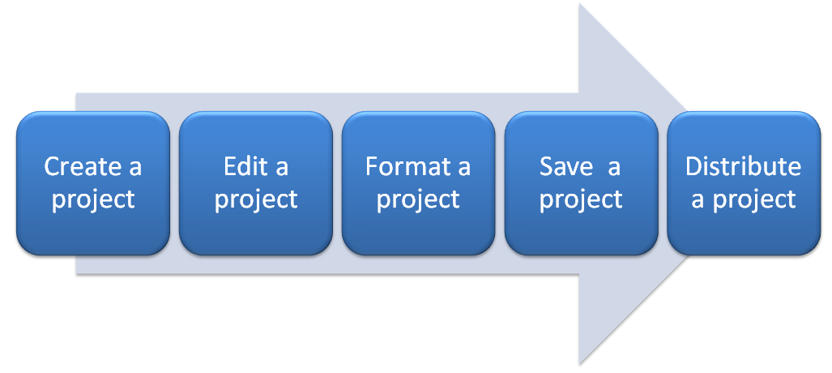
Productivity Applications (3 of 18)
With productivity applications, users often:

Slide 19
Productivity Applications (4 of 18)
Word processing software allows users to create and manipulate documents
People use word processing software to develop documents such as letters, memos, reports, mailing labels, and newsletters

Slide 20
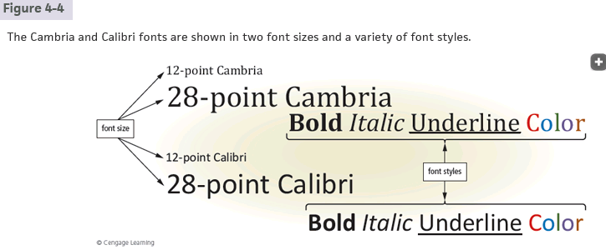

Slide 21
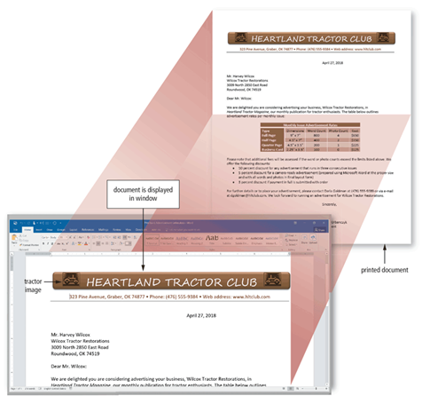
Figure 4-5 Word processing software enables users to create professional and visually appealing documents.

Slide 22
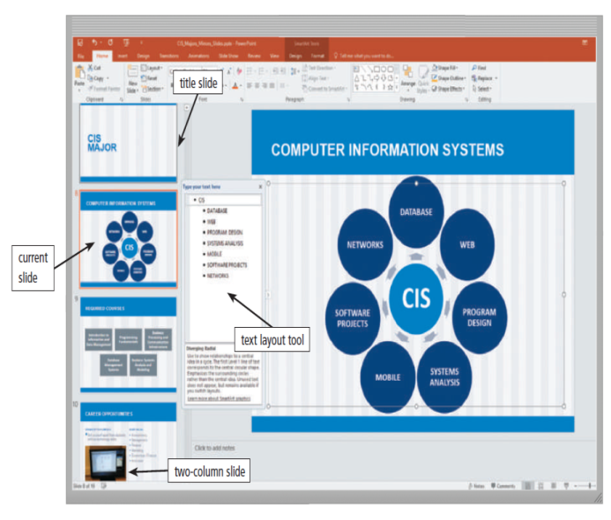
Presentation software allows users to create visual aids for presentations to communicate ideas, messages, and other information to a group
Figure 4-6 Presentation software provides tools for creating slides with content arranged in a variety of formats.

Slide 23
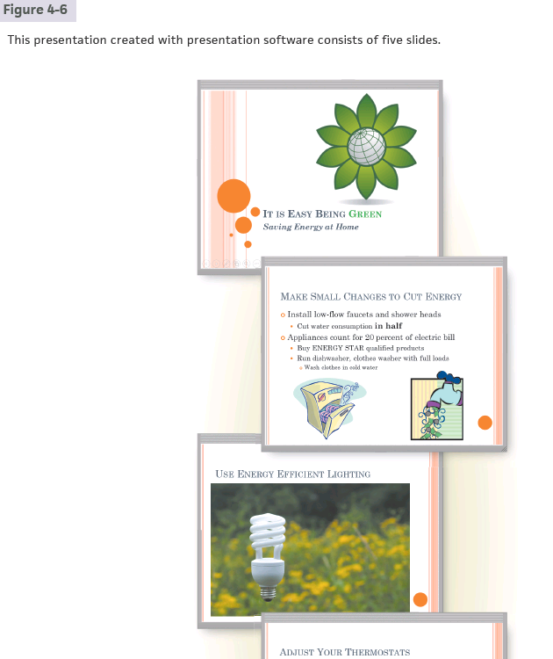

Slide 24
為何從google docs下載成word格式會爛掉
Font differences: sometimes word doesn’t have the same font, and is substituted by default font.
Layout Engine and Style/Template Differences
Page Size & Margin Settings
How to address: 下載成PDF(後面會講PDF)

Slide 25
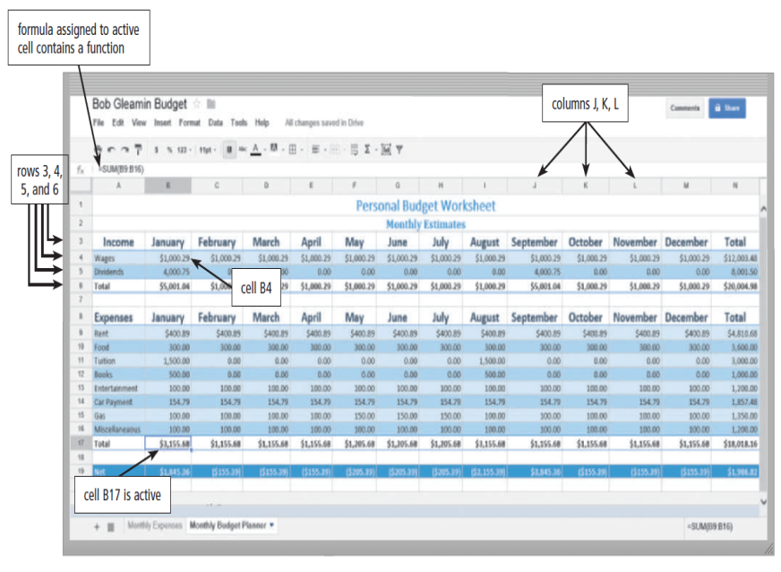
Spreadsheet software allows users to organize data in columns and rows and perform calculations on the data
Figure 4-7 With spreadsheet software, you create worksheets that contain data arranged in columns and rows, and you can perform calculations on the data in worksheets.

Slide 26
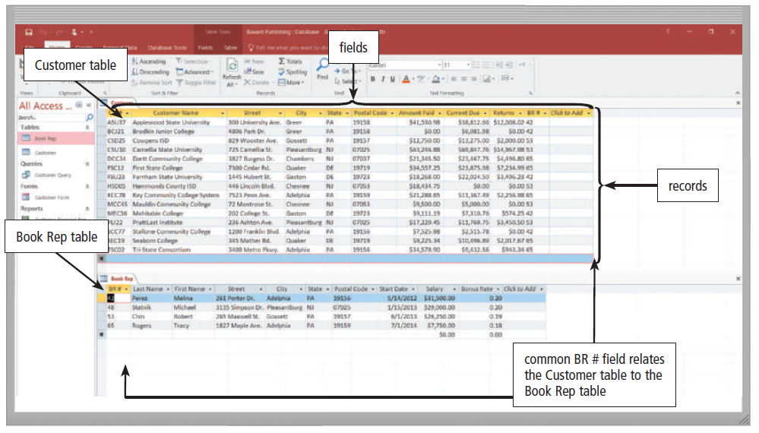
A database is a collection of data organized in a manner that allows access, retrieval, and use of that data
Database software allows users to create, access, and manage a database.
Figure 4-8 This database contains two tables: one for customers and one for book reps. The Customer table has 15 records and 10 fields; the Book Rep table has 4 records and 10 fields.

Slide 27
SQL(Structured Query Language)
A language that communicates with database
Turing data into tables
Can pull, edit, add, delete, join information into databases
How to use SQL?
e.g. python import pymysql

Slide 28
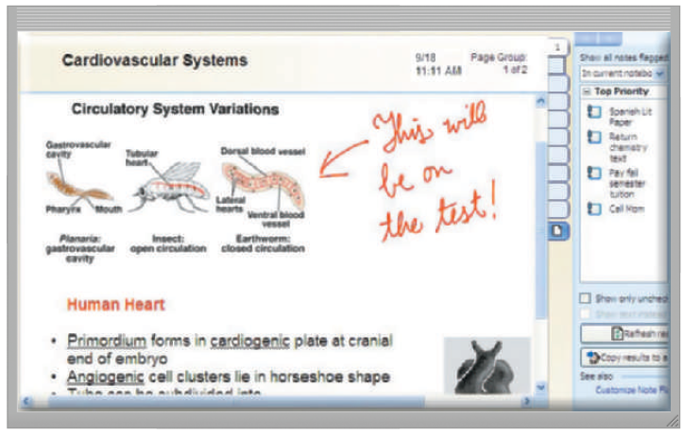
Note taking software is an application that enables users to enter typed text, handwritten comments, drawings, sketches, photos, and links anywhere on a page
Figure 4-9 With note taking software, mobile users can handwrite notes, draw sketches, insert photos and links, and type text.

Slide 29
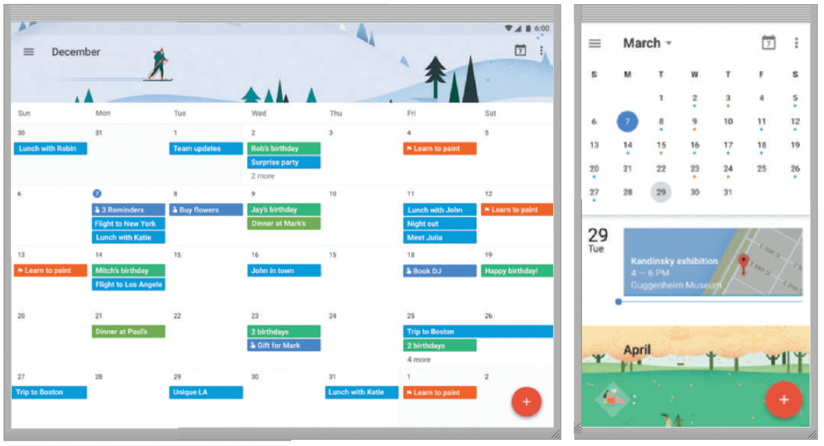
Calendar and contact management software helps you organize your calendar, keep track of contacts, and share this information with other users
Figure 4-10 Users access their calendars on computers and mobile devices.

Slide 30
Productivity Applications (11 of 18)
A software suite is a collection of individual related applications available together as a unit.
Project management software is an application that allows a user to plan, schedule, track, and analyze the events, resources, and costs of a project.

Slide 31
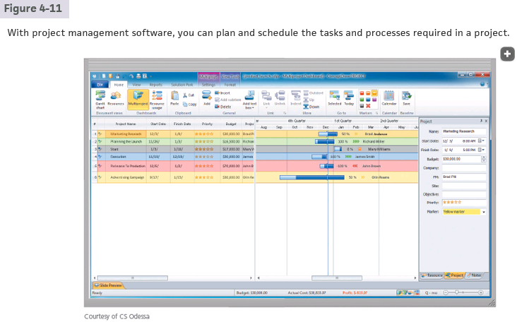

Slide 32
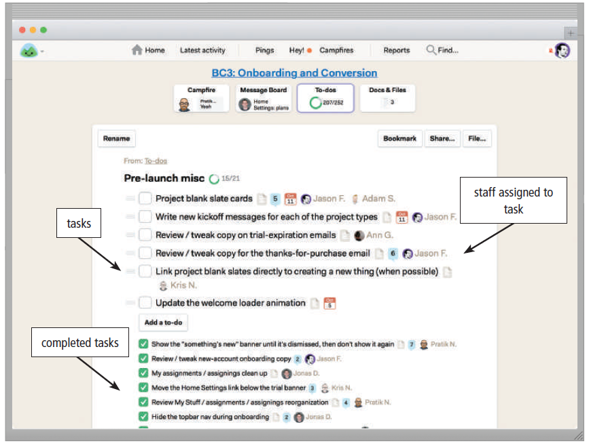
Figure 4-11 With project management software, you can plan and schedule the tasks and resources required in a project.

Slide 33
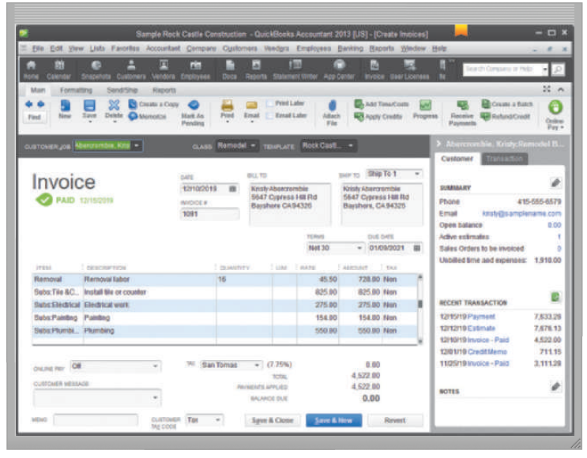
Accounting software is an application that helps businesses of all sizes record and report their financial transactions
可能會覺得和前面試算表有點像 但是會計有一些特別的標準
Figure 4-12 Accounting software helps businesses record and report their financial transactions.

Slide 34
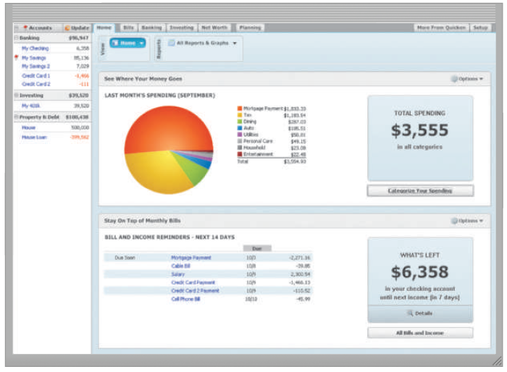
Personal finance software is a simplified accounting application that helps home users and small/home office users balance their checkbooks, pay bills, track personal income and expenses, verify account balances, transfer funds, track investments, and evaluate financial plans
Figure 4-13 Personal finance software assists home users with tracking personal accounts.

Slide 35
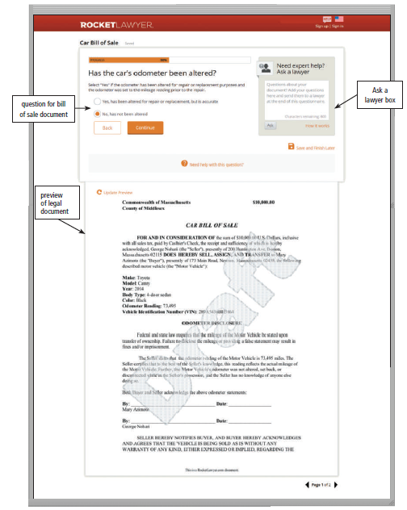
Legal software is an application that assists in the preparation of legal documents and provides legal information to individuals, families, and small businesses
Figure 4-14 Legal software assists individuals, families, and small businesses in the preparation of legal documents.

Slide 36
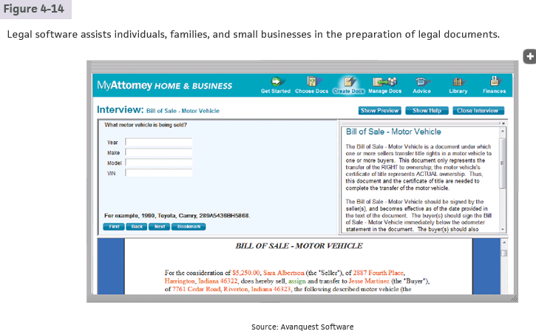

Slide 37
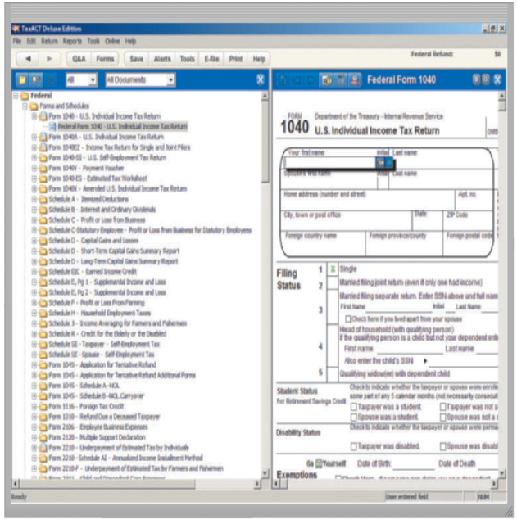
Tax preparation software is an application that can guide individuals, families, or small businesses through the process of filing federal and state taxes
Figure 4-15 Tax preparation software guides individuals, families, or small businesses through the process of filing federal taxes.

Slide 38
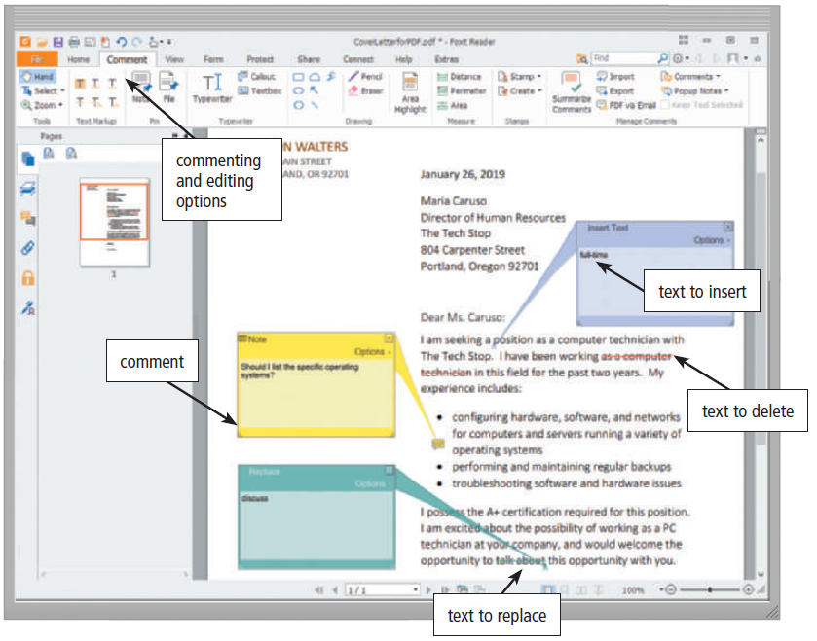
Document conversion software saves documents created in any application into a common format that has the same appearance as the original document
PDF: Portable Document Format
Figure 4-16 Users can edit content and add comments to a PDF document.

Slide 39
PDF
通常由文字、向量圖、點陣圖組成
為什麼PDF檔案通常比較小 → 經過一些壓縮技巧
壓縮的技巧 :
1. 點陣圖 JPEG → 捨棄一些細節
FLATE → 找重複資料(例如在只有黑白的圖很好用)
2. 向量圖 適度化簡公式
找到重複的公式
3. 文字 找重複的字
關鍵就是找到重複的，然後只存一次

Slide 40
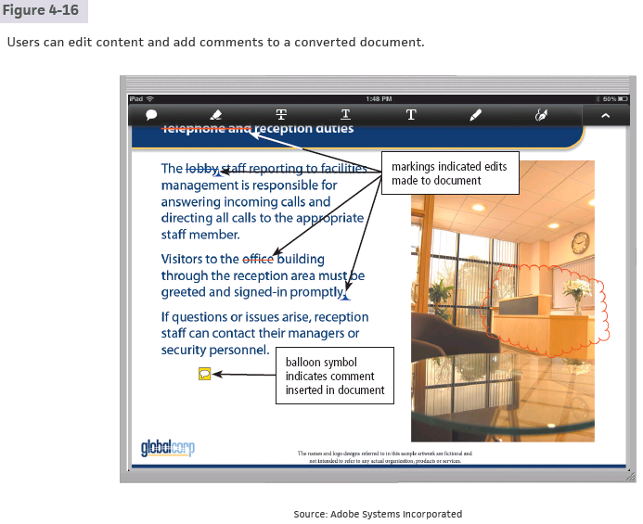

Slide 41
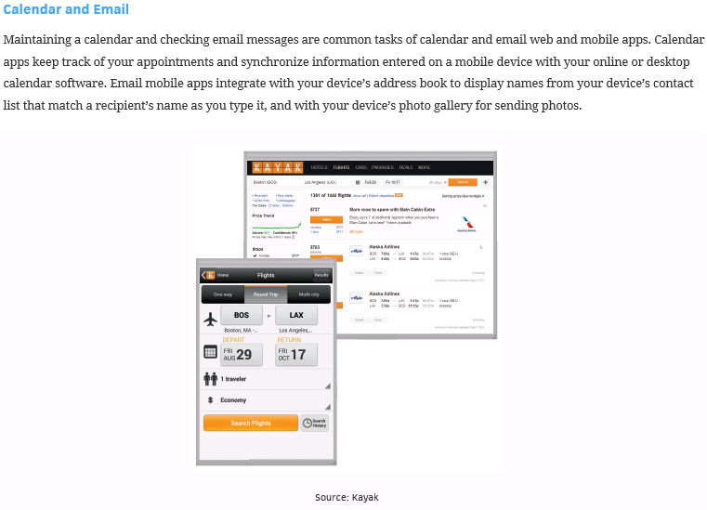

Slide 42
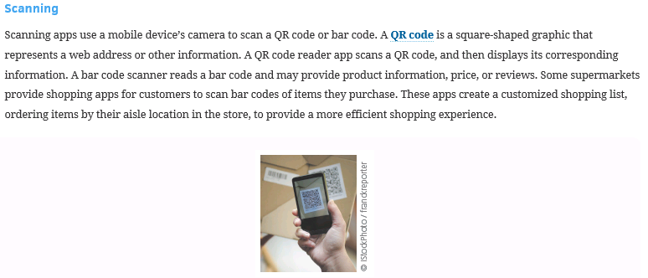
QR: Quick Response

Slide 43
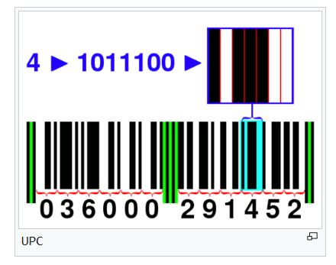
How does bar code work
起始碼 (Start) → 3 個模組（101）
系統碼 (Number System) → 1 位數字
左側數據碼 (Left Data) → 5 位數字（每位數字 7 個模組）
中間碼 (Middle Guard) → 5 個模組（01010）
右側數據碼 (Right Data) → 5 位數字
檢查碼 (Check Digit) → 1 位數字
終止碼 (End) → 3 個模組（101）
系統碼+左側數據碼+右側數據碼+檢查碼 有12位數字
檢查碼計算方式（UPC-A）：
把「奇數位」的數字相加 × 3 (用上面的: 14*3=42)
加上「偶數位」的數字 (用上面的: 42+16=58)
找到一個最小的數字，使得總和 + 這個數字 ≡ 0 (mod 10)
(用上面的: 58+2 ≡ 0 (mod 10)，其中2是最小可能)
所以可以看到上面那張圖的check digit是2

Slide 44
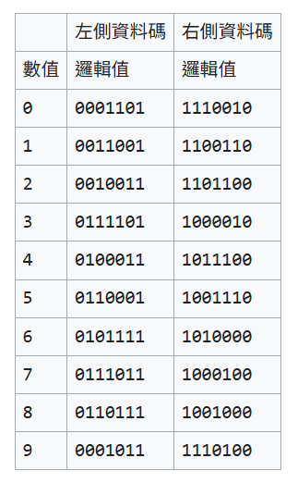
How does bar code work
圖片來源: 維基百科

Slide 45
How about QR code
跟bar code有點像，都是用黑白代表0/1存資料，經過區塊分散化形成QR code
定位圖樣: 在左上、右上、左下的大方格，告訴scanner QR code的方向
特色:
1. 能存的資料量大(最多7000個數字 or 4000個字母)
2.可高達30%的容錯率(由於有一段保護訊息)
By chatGPT: 它把資料想成一個多項式，然後生成一些「多餘的點」。 只要損毀沒有超過「能容忍的比例」，就能解方程式，還原出完整資料。

Slide 46
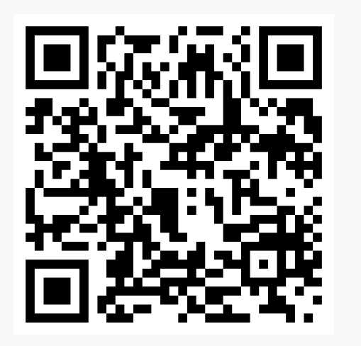
How about QR code
scannable(雖然稍有損毀)
Not scannable(因為無法辨認方向了)

Slide 47
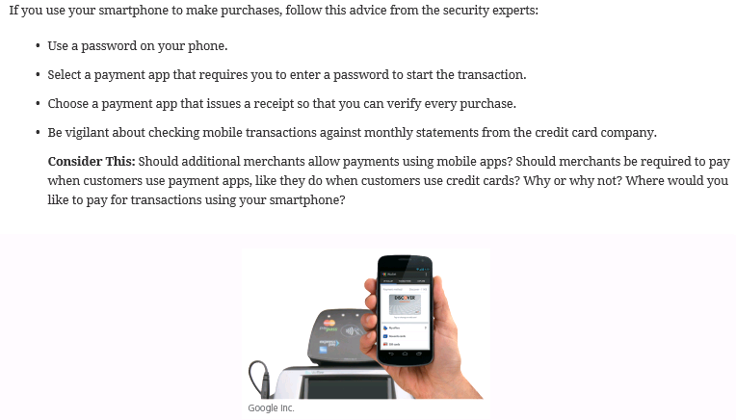

Slide 48
Productivity Applications (18 of 18)
A large organization, commonly referred to as an enterprise, requires special computing solutions because of its size and geographic distribution
Human resources software
Accounting and finance software
Engineering or product development software
Manufacturing software
Marketing software
Sales software
Distribution software
Customer service software
Information technology software

Slide 49
Graphics and Media Software (1 of 5)
Computer-Aided Design (CAD) software
2D繪圖, 3D建模 設計建築或機械零件、電路
Desktop publishing software
Paint/Image editing software
電腦繪圖
Photo editing and photo management software 修圖
Video and audio editing software

Slide 50
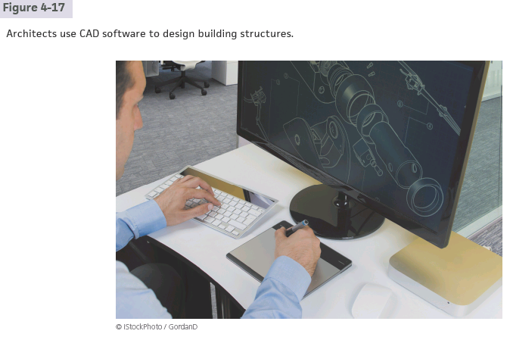
CAD: Computer-Aided Design

Slide 51
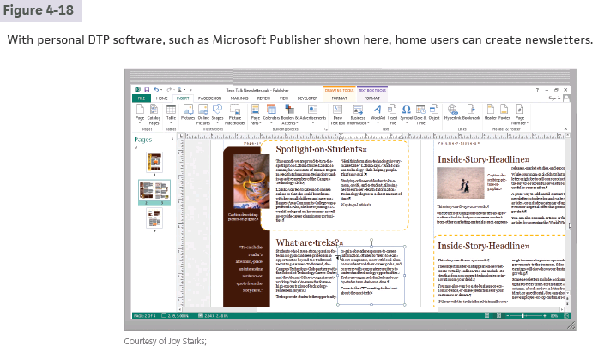
DTP: Desk-Top Publishing

Slide 52
Graphics and Media Software (2 of 5)
Multimedia authoring software allows users to combine text, graphics, audio, video, and animation in an interactive application
Website authoring software helps users create business websites for a variety of purposes

Slide 53
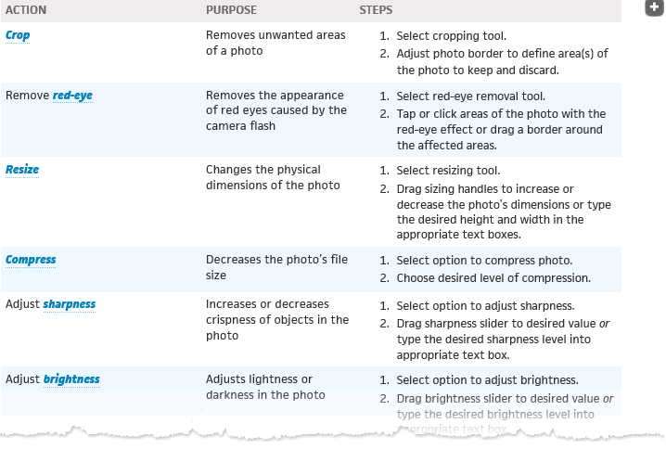

Slide 54
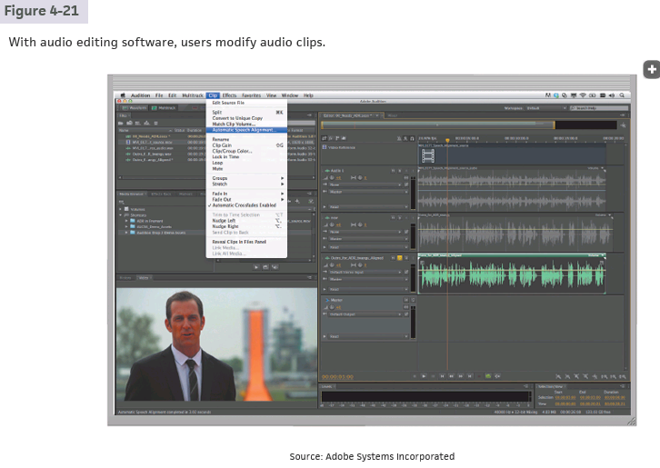

Slide 55
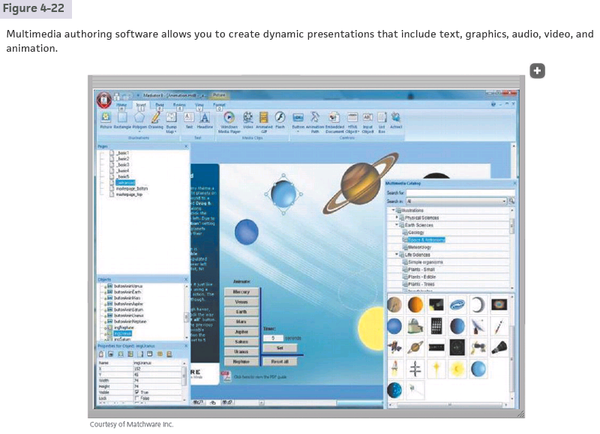

Slide 56
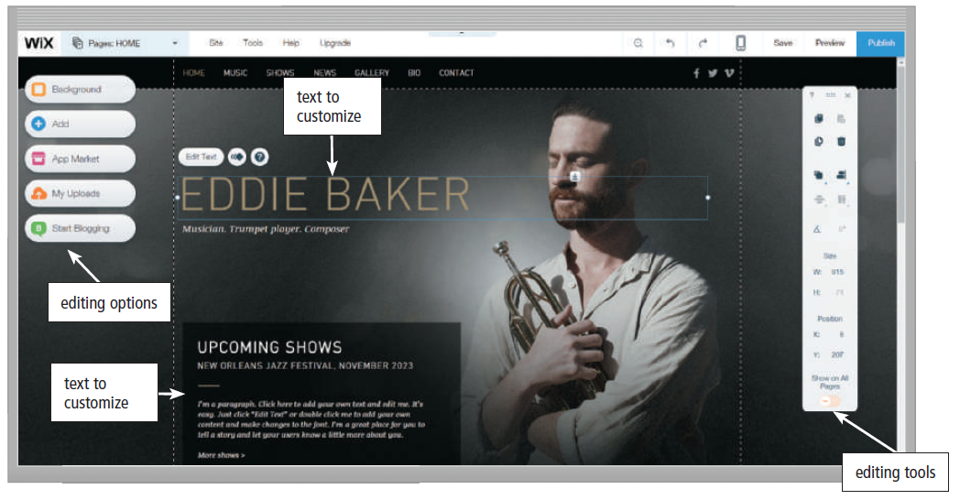
Graphics and Media Software (3 of 5)
Figure 4-22 Website authoring software allows you to create engaging personal and business websites by adding your text, images, and videos to existing website templates.

Slide 57
Graphics and Media Software (4 of 5)
A media player is a program that allows you to view images and animations, listen to audio, and watch video files on your computer or mobile device
An augmented reality app overlays information and digital content on top of physical objects or locations
A virtual reality app provides an immersive user experience

Slide 58
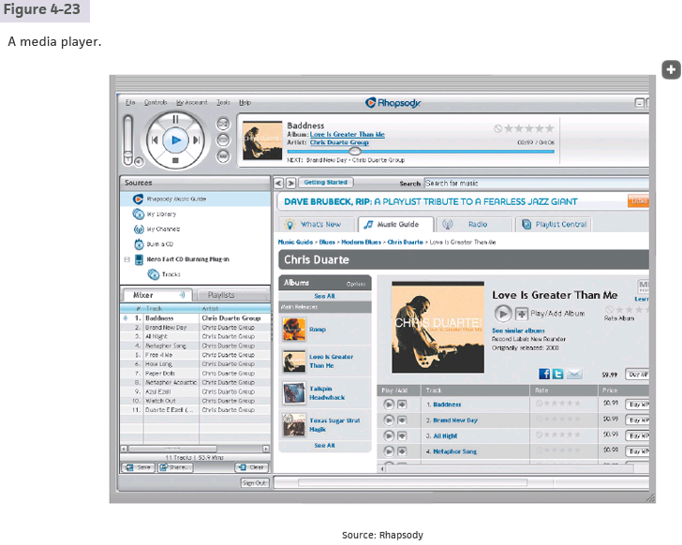

Slide 59
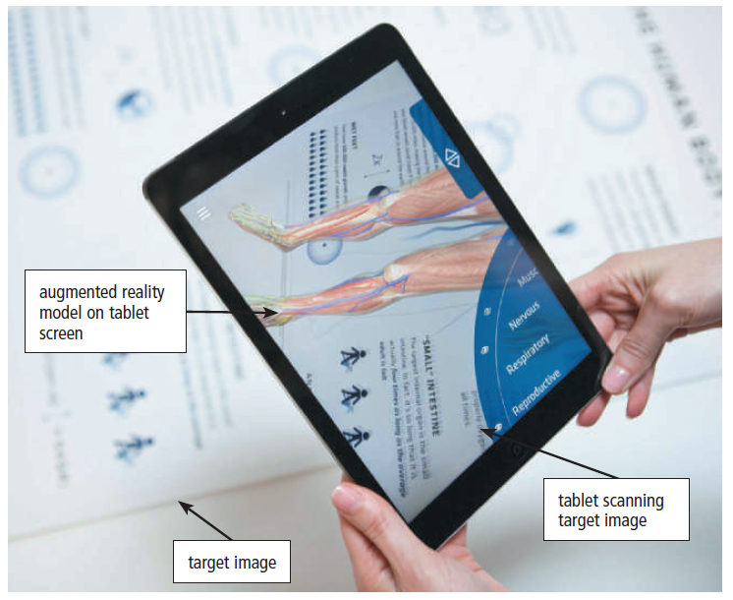
Graphics and Media Software (5 of 5)
Figure 4-23 Scanning a target image with a tablet or smartphone displays an
interactive model of the human body in this augmented reality app used for medical education.

Slide 60

Personal Interest Applications
Lifestyle applications e.g. Pinterest
Medical applications e.g.健保快易通
Entertainment applications
e.g. Netflix, Spotify, Your games
Convenience applications
e.g. Google map, Uber, LINE Pay
Education applications
e.g. Duolingo

Slide 61
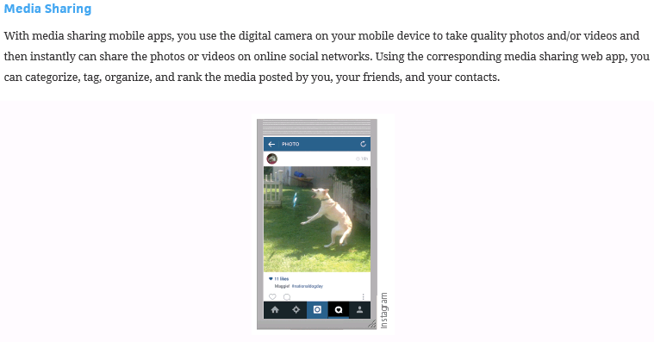

Slide 62
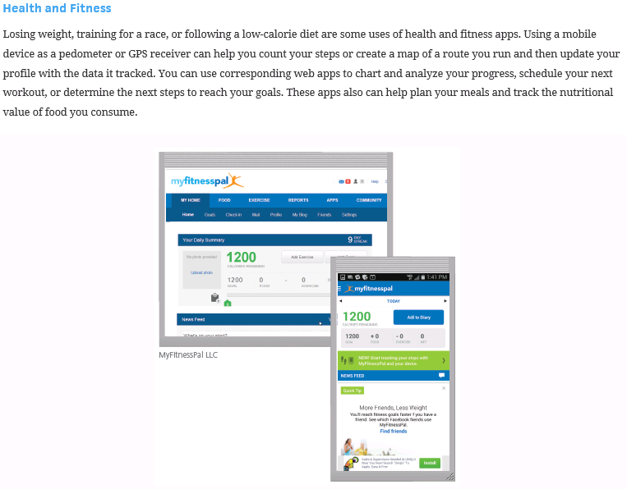

Slide 63
Communications Applications
Blog
Browser
Chat
Online Discussion e.g. reddit, StackOverflow
Email
File Transfer
Internet Phone
Internet Messaging
Mobile (Text) Messaging
Videoconference

Slide 64
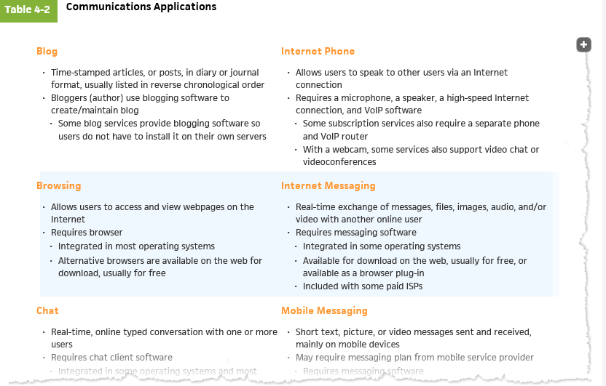
VoIP: Voice over Internet Protocol

Slide 65
Security
What’s a computer virus: 用來破壞、竊取、控制或干擾系統or資料的程式
Where does a virus come from:
1. Phishing link/attachments
2. drive-by downloads(偽裝自己是正常程式)
3. USB
4. Social engineering

Slide 66
Security
What does a virus do:
Computer viruses generally require a host program. The virus writes its own code into the host program. When the program runs, the written virus program is executed first, causing infection and damage. -wiki
1. Privilege escalation
2. Remote Access Trojan, RAT
連回攻擊者的伺服器，控制你的電腦
3. lateral movement
橫向存取同一網路內其他機器
4. Identity theft, System damage, extort

Slide 67
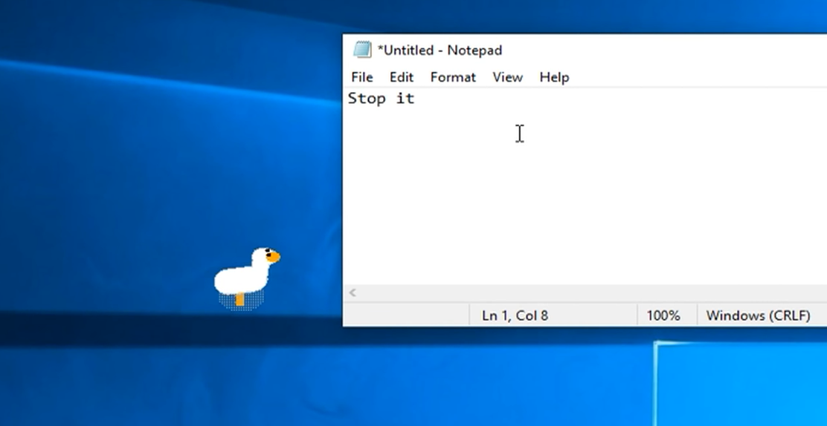
Desktop goose

Slide 68
Security
Firewall:
1. Check whether the resource IP is suspicious or not
2. Block unknown external connection requests
3. Limit external connections from internal programs
不會深度檢查檔案本身是不是病毒。

Slide 69
Security
Anti-virus program:
Check the code structure of a program、detect suspicious API calls
Detect whether a program is trying to encrypt files when running (代表他可能想勒索你)
Run the suspicious program in a virtual and isolated environment and see what it does
缺點: 防毒軟體要執行掃描 → 他有比較高的權限 →
可能反而變成攻擊目標

Slide 70
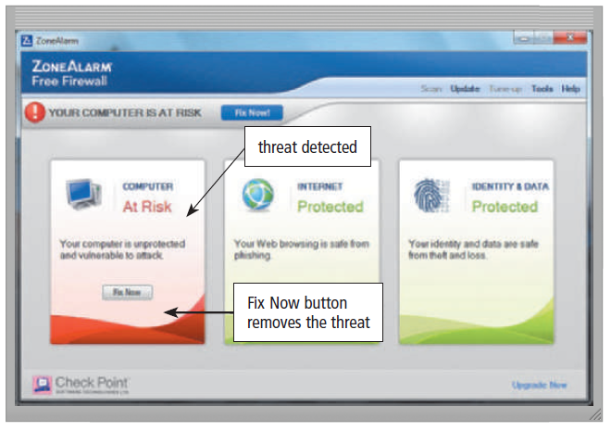
A personal firewall is a security tool that detects and protects a personal computer and its data from unauthorized intrusions
Figure 4-24 This personal firewall detected a threat to the computer and
provided a means to remove the threat.

Slide 71
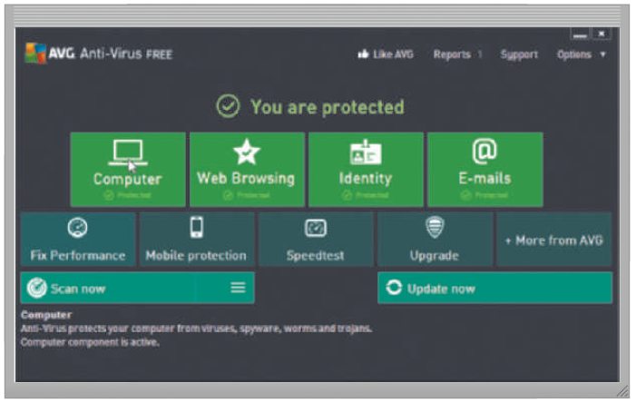
An antivirus program protects a computer against viruses by identifying and removing any computer viruses found in memory, on storage media, or on incoming files
Figure 4-25 An antivirus program scans memory, media, and incoming email messages and attachments for viruses and attempts to remove any viruses it finds.

Slide 72
Security Tools (slide 3 of 5)
Spyware is a type of program placed on a computer or mobile device without the user’s knowledge that secretly collects information about the user and then communicates the information it collects to some outside source while the user is online
Adware is a type of program that displays an online advertisement in a banner or pop-up or pop-under window on webpages, email messages, or other Internet services

Slide 73
Security Tools (slide 4 of 5)
A spyware remover is a type of program that detects and deletes spyware and similar programs
An adware remover is a program that detects and deletes adware

Slide 74
Security Tools (slide 5 of 5)
Anti-spam programs e.g. gmail spam filter
Web filtering software e.g. Net Nanny
Phishing filters 通常內建在防毒軟體裡面
Pop-up and pop-under blockers
e.g. AdBlocker

Slide 75
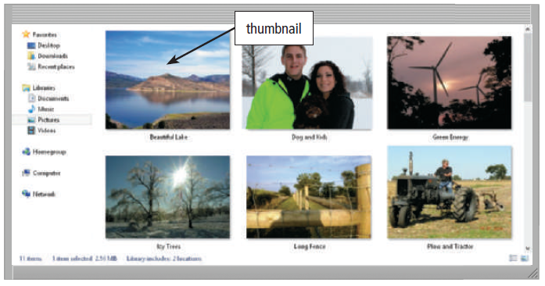
A file manager is a tool that performs functions related to file management
Figure 4-27 With a file manager, you can view folders and different types of files containing documents, photos, and music. In this case, thumbnails of photos are displayed.

Slide 76
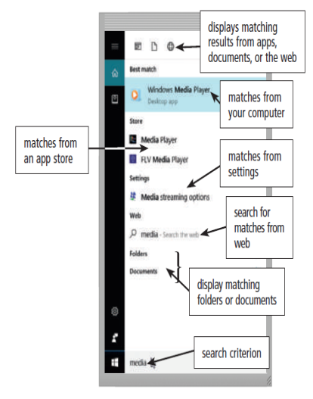
A search tool is a program, usually included with an operating system, that attempts to locate a file, contact, calendar event, app, or any other item stored on your computer or mobile device based on criteria you specify
Figure 4-28 Search tools locate apps, folders, files, settings, and other items on your device or the web that match a search criteria

Slide 77
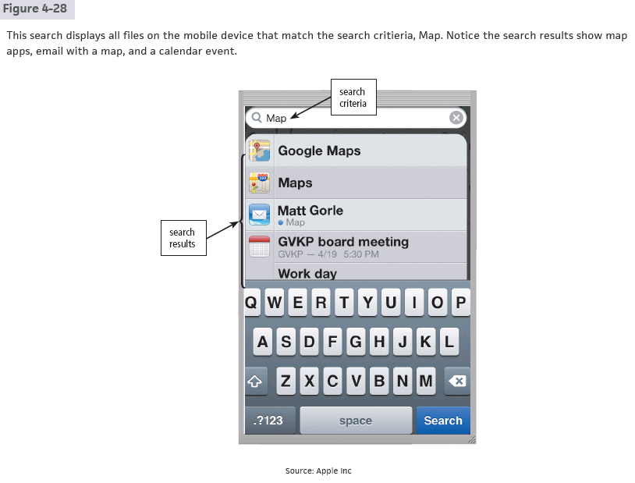

Slide 78
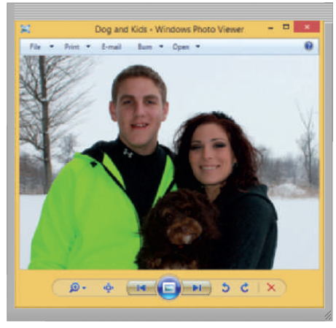
An image viewer is a tool that allows users to display, copy, and print the contents of a graphics file, such as a photo.
An uninstaller is a tool that removes a program, as well as any associated entries in the system files.
Figure 4-29 An image viewer allows users to see the contents of a photo file.

Slide 79
Cache(快取)
It’s faster to access data from cache than from the main memory
存最近用到或常用到的data
Cache replacement algorithm
- FIFO (很好做 但是通常不符合實際情況)
- LRU (實做比較複雜 但比較符合實際情況)
- LFU (最少用的踢掉)

Slide 80
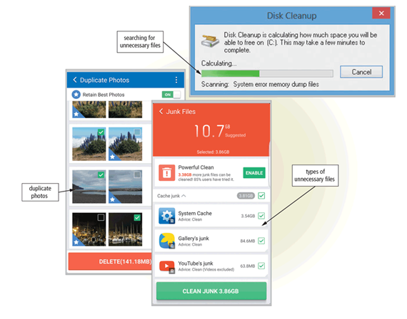
A disk cleanup tool searches for and removes unnecessary files
Figure 4-30 A disk cleanup tool searches for and removes unnecessary files on a computer or mobile device.

Slide 81
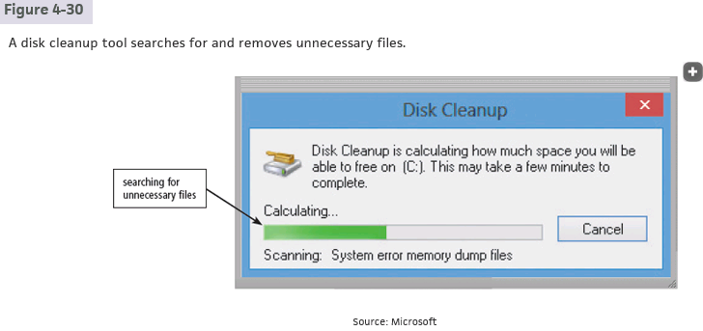

Slide 82
Disk defragmenter 磁碟重組
HDD(機械硬碟) 有磁頭，用磁頭移動到正確位置做讀寫
SSD(固態硬碟) 電子式存取，能很快找到正確位置
HDD會需要Disk defragmenter，不然磁頭一直移動比較容易毀損
Disk defragmenter的功能就是把不連續的檔案碎片變成連續的，這樣之後要讀寫就比較快(不用一直讓磁頭去找)

Slide 83

A disk defragmenter is a tool that reorganizes the files and unused space on a computer’s hard disk so that the operating system accesses data more quickly and programs run faster.
Defragmenting
Figure 4-31 A fragmented hard disk has many files stored in noncontiguous sectors. Defragmenting reorganizes the files so that they are located in contiguous sectors, which speeds access time.

Slide 84

File, Disk, and System Management Tools (6 of 7)
A screen saver is a tool that causes a display device’s screen to show a moving image or blank screen if no keyboard or mouse activity occurs for a specified time

Slide 85
File, Disk, and System Management Tools (7 of 7)
A file compression tool shrinks the size of a file(s)
A PC maintenance tool is a program that identifies and fixes operating system problems, detects and repairs drive problems, and includes the capability of improving a computer’s performance

Slide 86
File, Disk, and System Management Tools (7 of 7)
A backup tool allows users to copy, or back up, selected files or the contents of an entire storage medium to another storage location
A restore tool reverses the process and returns backed up files to their original form
A power management tool monitors a laptop or mobile device’s battery usage, showing apps that consume the most battery power, displaying battery usage since the device was last charged, and estimating usage time remaining

Slide 87


Slide 88


Slide 89
Summary
Role of the operating system
Programs and apps available for computers and mobile devices
Features of a variety of applications
Communications applications
Security tools and file, disk, and system management tools

Slide 90
Funny videos
https://www.youtube.com/watch?v=b3JLr9BShE0
https://www.youtube.com/watch?v=Z3DIFSf5VcI

Slide 91
Project due Oct. 6, 2025
Use Microsoft Word to type our textbook page.
The page number is 100 + the last two digits of your ID number.
Try to type the page as similar to textbook as possible.
Scan images if necessary, but try to use as much text as possible.
Type another page with Microsoft Word to show off your capability.
Include as much graphics, sounds, HTML, mail merge, style, font, type, ... as possible.

